Slide 1
Virtual Machine Automation
Project Participants
Parthkumar Barot (C0695511)
Harsh Patel (C0693162)

Slide 2
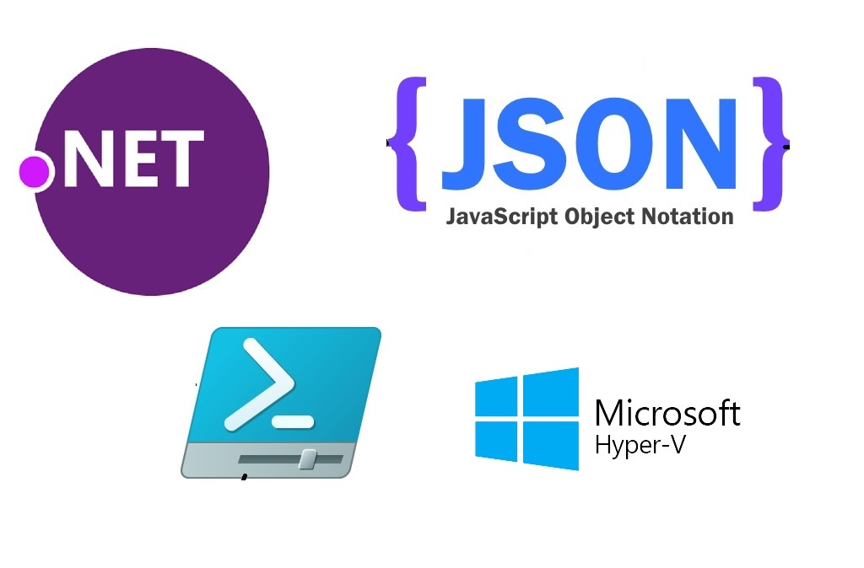
Structure

Slide 3
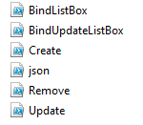
Files…
Powershell Scripts

Slide 4
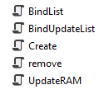
Files…
JSON

Slide 5
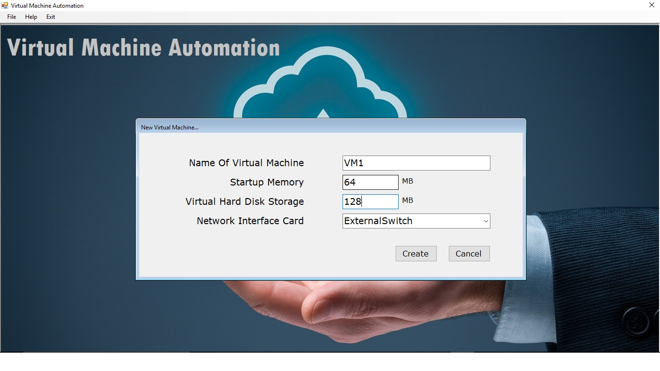
1. Add Virtual Machine (Screenshot)

Slide 6
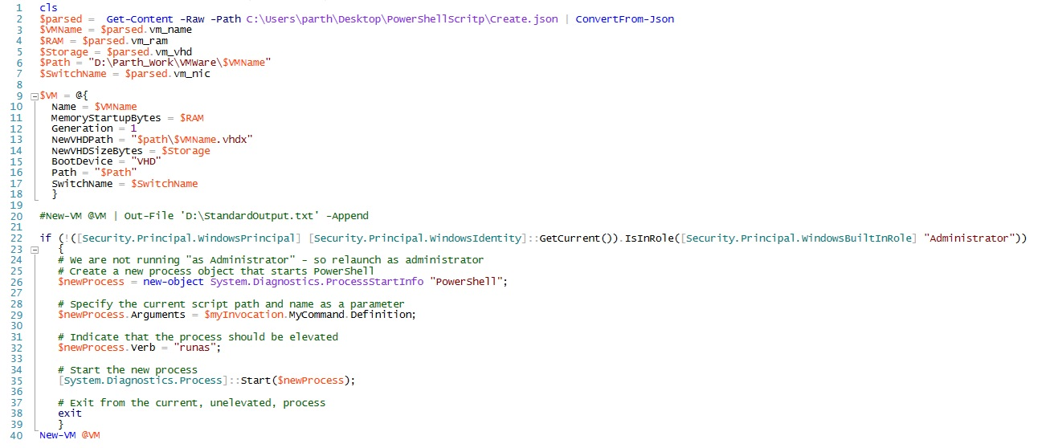
1. Add Virtual Machine (Programming Code)

Slide 7
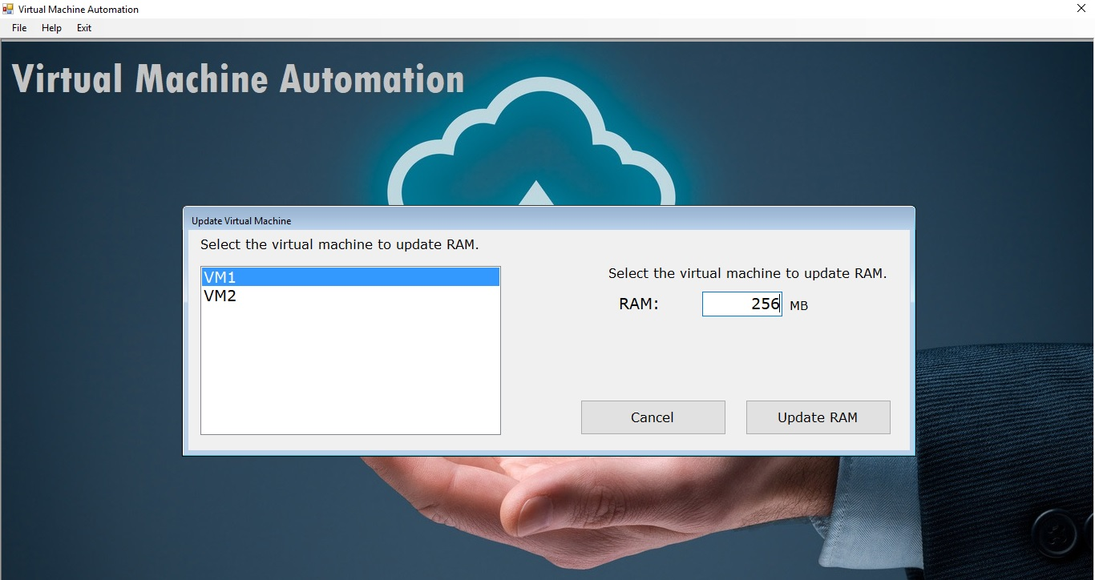
2. Update Virtual Machine (Screenshot)

Slide 8
2. Update Virtual Machine (Programming Code)
Stop-VM $VMName
Set-VM -StaticMemory -Name $VMName -MemoryStartupBytes $RAM
Start-VM $VMName

Slide 9
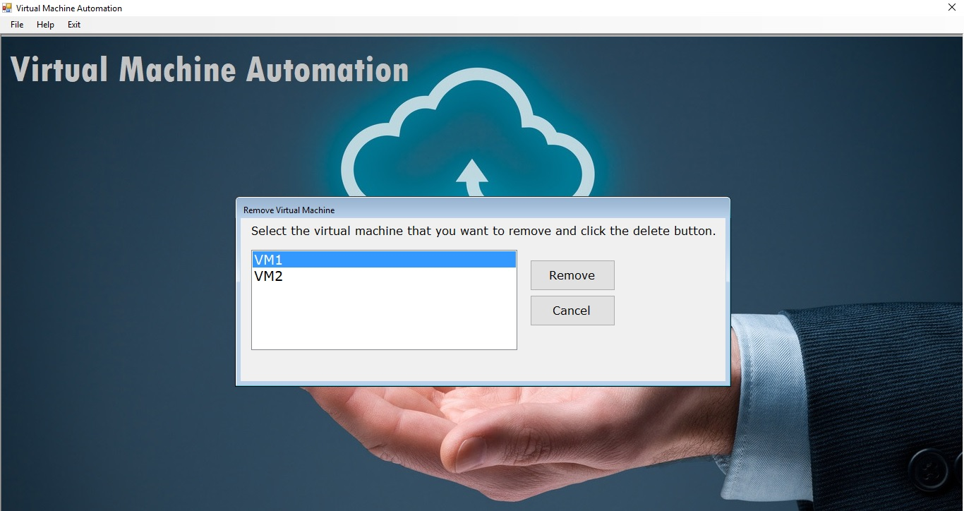
3. Remove Virtual Machine (Screenshot)

Slide 10
3. Remove Virtual Machine (Programming Code)
Stop-VM $VMName
Remove-VM $VMName
Remove-Item -Path $Path

Slide 11
4. Other Commands
To Get Details of Virtual Machine
Get-VM | Where State -eq ‘Running’ |
select VMName, MemoryAssigned |
ConvertTo-Json |
Out-File C:\Users\parth\Desktop\PowerShellScritp\BindUpdateList.json

Slide 12
Future Enhancement…
Web Application
Operating System
Storage Upgradation
NIC Switch Creation
Back Up with Database

Slide 13
Thank You..!!

